Slide 1
Microsoft Power BI
Microsoft Power BI is a collection of software services, apps, and connectors that work together to turn your unrelated sources of data into coherent, visually immersive, and interactive insights.

Slide 2
What is Power BI?
Power BI (Business Intelligence) comes into play.
Your data is a simple Microsoft Excel workbook, or a collection of cloud-based and on-premises hybrid data warehouses, Power BI lets you easily connect to your data sources, clean, and model your data without affecting the underlying source, visualize (or discover) what's important, and share that with anyone or everyone you want.
Power BI consists of a Microsoft Windows desktop application called Power BI Desktop, an online SaaS (Software as a Service) service called the Power BI service, and mobile Power BI apps that are available on phones and tablets.

Slide 3
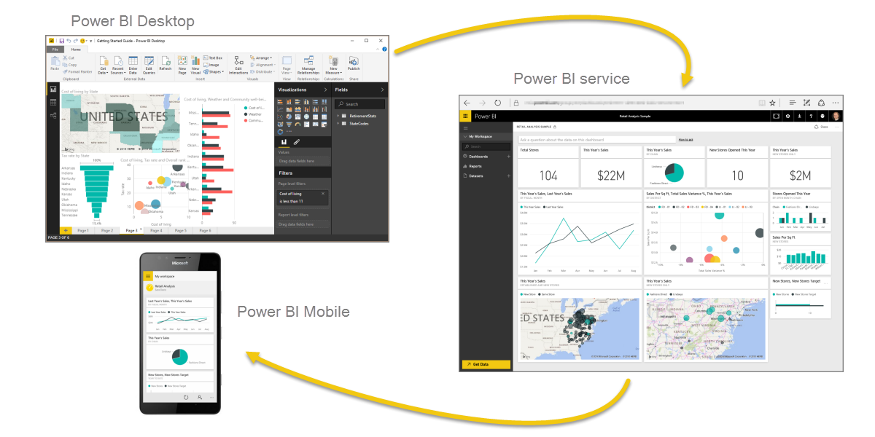
The parts of Power BI

Slide 4
The Power BI concepts
major building blocks of Power BI are: datasets, reports, and dashboards. They are all organized into workspaces, and they are created on capacities.

Slide 5
Capacities
Capacities are a core Power BI concept representing a set of resources used to host and deliver your Power BI content. Capacities are either shared or dedicated. A shared capacity is shared with other Microsoft customers, while a dedicated capacity is fully committed to a single customer. Dedicated capacities require a subscription. By default, workspaces are created on a shared capacity.

Slide 6
Workspaces
Workspaces are containers for dashboards, reports, datasets, and dataflows in Power BI. There are two types of workspaces: My workspace and workspaces.
My Workspace is the personal workspace for any Power BI customer to work with your own content. Only you have access to your My workspace. You can share dashboards and reports from your My Workspace. If you want to collaborate on dashboards and reports, or create an app, then you want to work in a workspace.
Workspaces are used to collaborate and share content with colleagues. You can add colleagues to your workspaces and collaborate on dashboards, reports, and datasets. With one exception, all workspace members need Power BI Pro licenses.
Workspaces are also the places where you create, publish, and manage apps for your organization. Think of workspaces as staging areas and containers for the content that will make up a Power BI app. So what is an app? An app is a collection of dashboards and reports built to deliver key metrics to the Power BI consumers in your organization. Apps are interactive, but consumers cannot edit them. App consumers, the colleagues who have access to the apps, do not necessarily need Pro licenses.

Slide 7
Datasets
Datasets are associated with workspaces and a single dataset can be part of many workspaces.
When you open a workspace, the associated datasets are listed under the Datasets tab. Each listed dataset represents a single source of data.
A dataset is a collection of data that you import or connect to.
Power BI lets you connect to and import all sorts of datasets and bring all of it together in one place. Datasets can also source data from dataflows.

Slide 8
For example of datasets:
an Excel workbook on OneDrive, or an on-premises SSAS tabular dataset, or a Salesforce dataset. There are many different data sources supported. Datasets added by one workspace member are available to the other workspace members with an admin, member, or contributor role.

Slide 9
Shared Datasets:
Business intelligence is a collaborative activity. It's important to establish standardized datasets that can be the 'one source of truth’.
When expert data modelers in your organization create and share optimized datasets, report creators can start with those datasets to build accurate reports.
To consume these shared datasets just choose Power BI datasets when creating your Power BI report.

Slide 10
Reports
A Power BI report is one or more pages of visualizations such as line charts, maps, and treemaps. Visualizations are also called visuals.
You can create reports from scratch within Power BI, import them with dashboards that colleagues share with you, or Power BI can create them when you connect to datasets from Excel, Power BI Desktop, databases, and SaaS applications.
For example, when you connect to an Excel workbook that contains Power View sheets, Power BI creates a report based on those sheets. And when you connect to a SaaS application, Power BI imports a pre-built report.

Slide 11
Dashboards
DASHBOARDS
A dashboard is something you create in the Power BI service .
Why do people create dashboards? Here are just some of the reasons:
1 to see, in one glance, all the information needed to make decisions.
2.to monitor the most-important information about your business.
3.to ensure all colleagues are on the same page, viewing and using the same information.
4.to monitor the health of a business or product or business unit or marketing campaign, etc.
5.to create a personalized view of a larger dashboard and show all the metrics that matter to them.

Slide 12
What is Dax Function?
DAX is a formula expression language which is called (DAX) which can be used with various visualization tools like Power BI. It is also known as a functional language, where the full code is kept inside a function. DAX programming formulas contain two data types: Numeric and Other.
Each is linked to the other by having common columns. Here is a simple diagram of Power BI Dashboard Example showing the relationships.

Slide 13
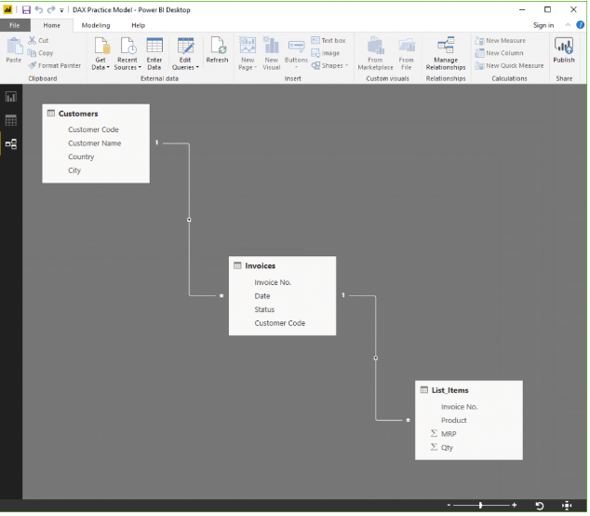

Slide 14
Calculated Columns
Calculated column allows you to create new columns based on the given data.
For example, there is no ' Final price' column available in the Items table. Here, the DAX function is used to calculate a new column when only total price & quantity are available.
Price = List_Items[MRP]*List_Items[Qty]
In the data shown in above Power BI example, each row will now have the respective calculated price.
Price = List_Items[MRP]*List_Items[Qty]
In the data shown in above Power BI example, each row will now have the respective calculated price.

Slide 15
Measures
You can perform a calculation using measure without the need to add any data as shown in the below Power BI example. This is very helpful for reports where the price can be displayed, without requiring an entirely new column to store it.
Example:
1] Total of the MRP column * Total of Qty column
Example:
1] Total of the MRP column * Total of Qty column

Slide 16
Tables
DAX functions in tabular model return entire tables. For example, In order to generate a list of all the country the organization
has clients in, use the function: cities touched = DISTINCT(Customers[City])
A word on Filters
Filters hide rows that don't fit given criteria. A calculation after filtering out data will be applicable only on a row which matches those criteria.

Slide 17
Power BI DAX Functions
Some Important DAX functions are:
Average
This DAX function allows you to find the average from a given set of values as shown in the below Power BI example.
Max
Example - AvgComm = AVERAGE(List_Items[Price])
Helps you to find the maximum from a given set of values.
Example – Find out the highest order. HighSale = MAX(List_Items[Price])

